Slide 1
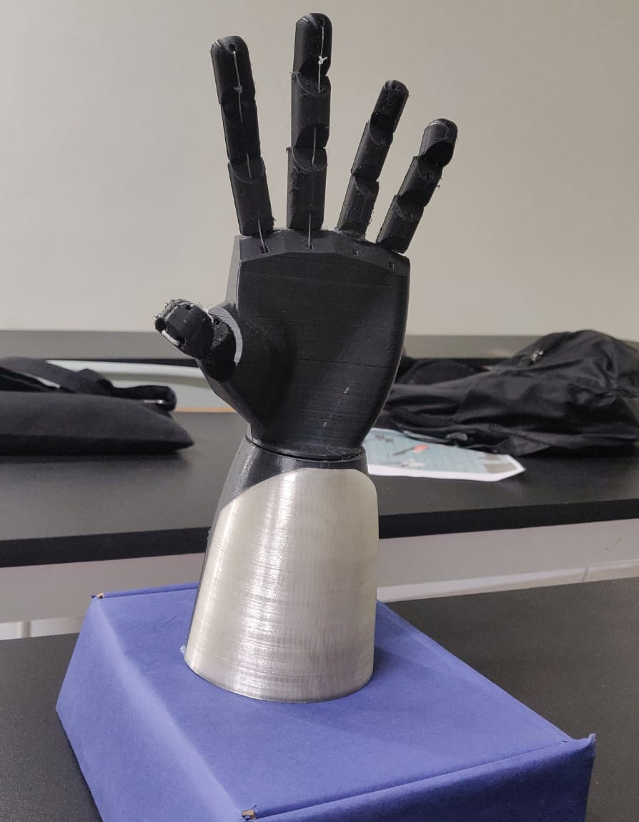
ROBOTIC ARM
Design Project

Slide 2
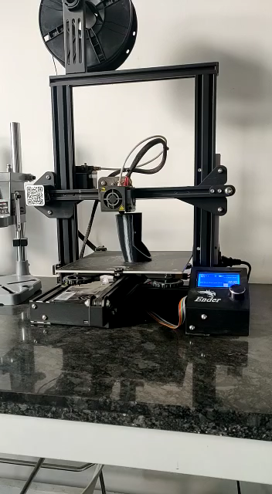
INTRODUCTION
In this study, a robot hand is designed to repeat finger movements depending upon flexible sensors mounted on any wearable glove.
In the literature, various sensors that detect the finger movement are used.
The determinations related to robot hand control are performed with Arduino UNO.

Slide 3
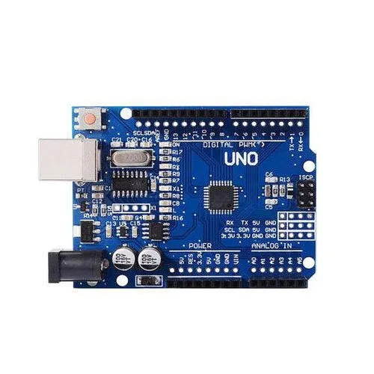
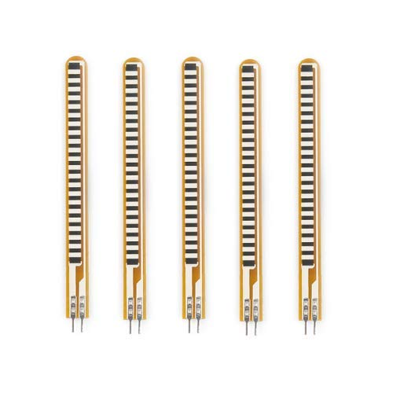

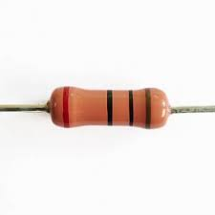
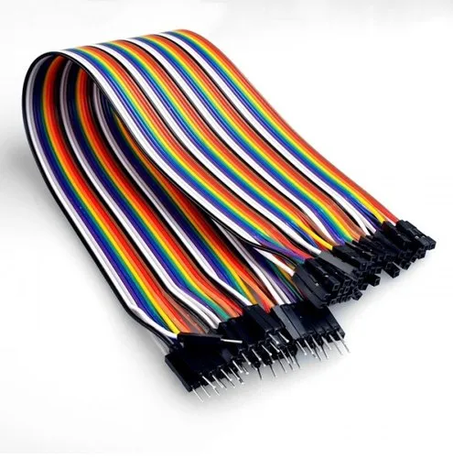
ARDUINO UNO
It is an open-source microcontroller board based on the Microchip ATmega328P microcontroller.
MATERIALS
Arduino UNO
Flex Sensor 2.2 inch
Servo Motor
Resistor 10k ohm
Transparent String
2/3mm Elastic Rope
Adhesive Glue
Glove
Breadboard
Jumper Wires
FLEX SENSOR
A flex sensor or bend sensor is a sensor that measures the amount of deflection or bending.
SERVO MOTOR
Servo motor works on PWM (Pulse width modulation) principle.
RESISTOR
A resistor is an electrical component that limits or regulates the flow of electrical current in an electronic circuit.
JUMPER WIRES
A jumper wire is an electric wire that connects remote electric circuits used for printed circuit boards.

Slide 4
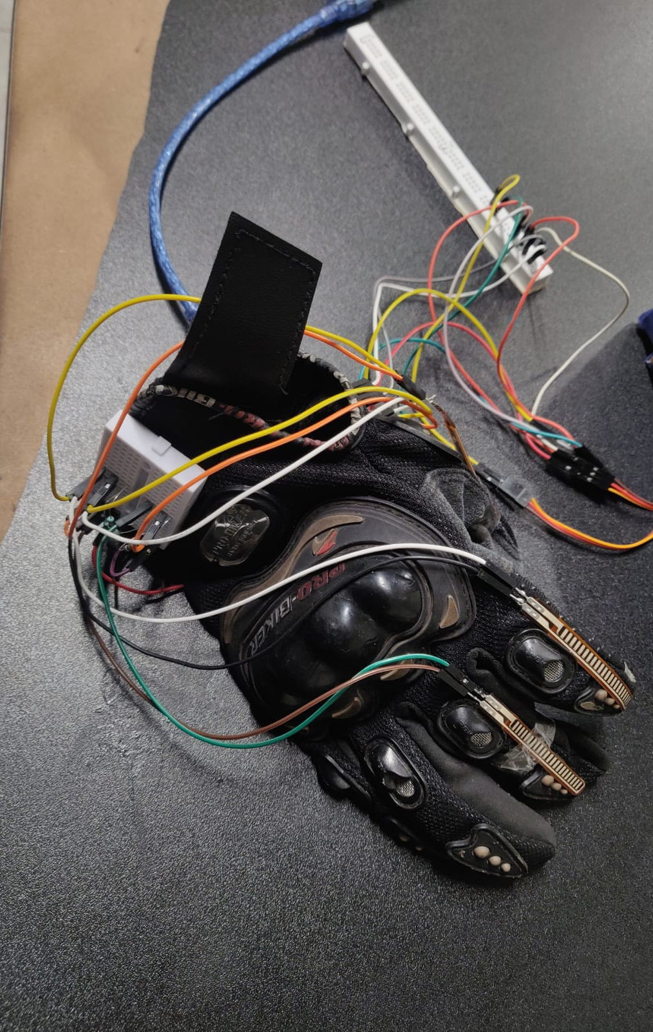
OBJECTIVE
The objective is to develop procedures that assist users to manage and program a robot, with a high-level of intellection from the robot specific language.
Presenting a robotic demonstration in terms of high-level behaviours like gestures, communication, manual navigation, visual observation of human performance, etc., the user will determine the mechanism what it have to do.
Therefore, new and a lot of intuitive ways are needed for mechanism programming and management.

Slide 5
DESCRIPTION
In this design we have used flex sensors for each finger to sense the movement of individual finger.
These 3 sensors are organized on a hand glove, which will make the sensors easy to wear.
The other part i.e. mechanical hand consists of 3 fingers which are controlled with the help of five servo motors, one motor for each finger.
All together it will be one hand consists of 3 flex sensor one in each finger.

Slide 6
WORKING
The whole circuit is powered by power bank and an Arduino UNO is used as the controlling unit.
The servo motor for robotic arm is controlled by glove.
Since the human fingers can be twisted in one direction according to their nature, a one-way flexibility sensor is chosen as the sensor in this study.
With the help of these sensors, servo motors can be controlled from 0° to 180°.
Robotic hand is the main instrument where implementation of the program from the robotic glove takes place.

Slide 7
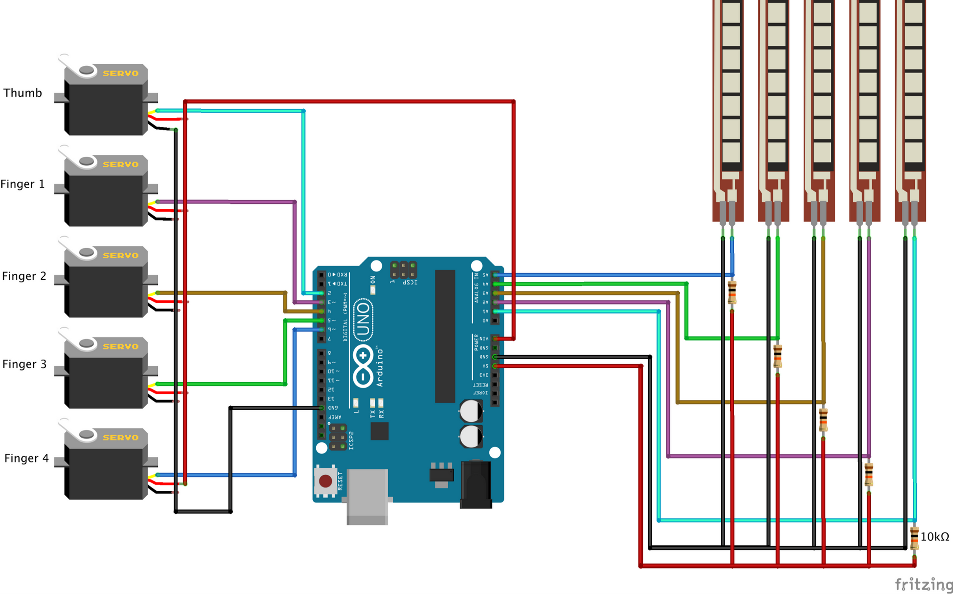
CIRCUIT DIAGRAM

Slide 8
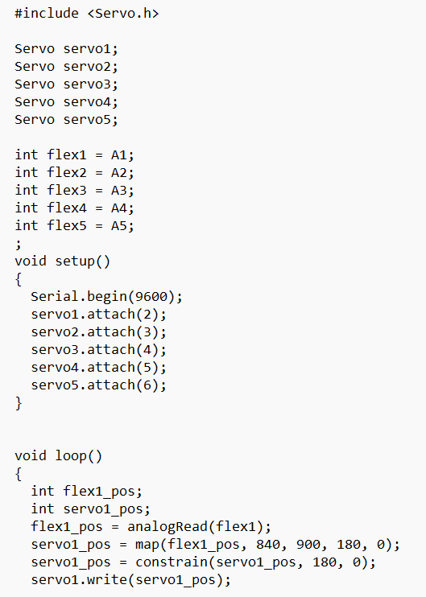
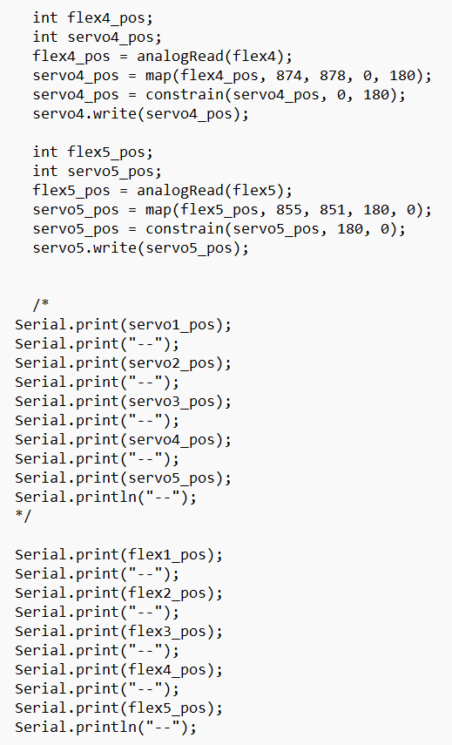
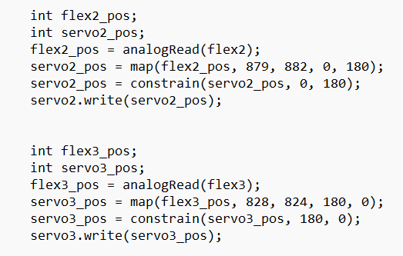
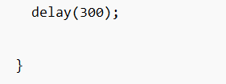
CODE

Slide 9
APPLICATIONS
Palletizing
Robotic arms can be used to automate the process of placing goods or products onto pallets.
Welding
It is a task that can be performed by robots in advanced industrial settings such as automotive
manufacturing.
Pick and Place
Identify an object, grasp it, and move it from one location to another —quickly and efficiently— to increase speed of production and distribution of goods.
Material Handling
Robotic arms can help create a safe and efficient warehouse by ensuring goods and materials are properly stored, easy to find, or transported correctly.
Inspection
Performing quality inspection is typically completed at the end of a production line, which delays the detection of production quality issues.

Slide 10
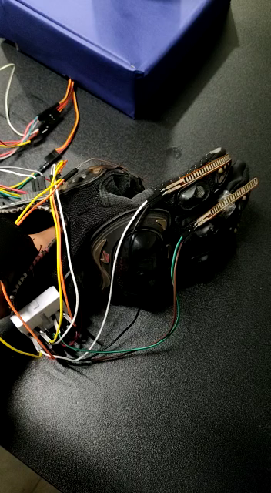
CONCLUSION
It has been observed that finger movements are imitated with high accuracy without any problems because of flexible sensors mounted on any glove.
This system is possible that the robot hand will become commercially more widespread since it is low cost.
This Robotic Hand is useful for the society as well as manufacturing applications and works successfully at the time of demonstration.
Micro controller based programs can be flexibly modified to suit the necessary drive control of the serve motor.

Slide 11
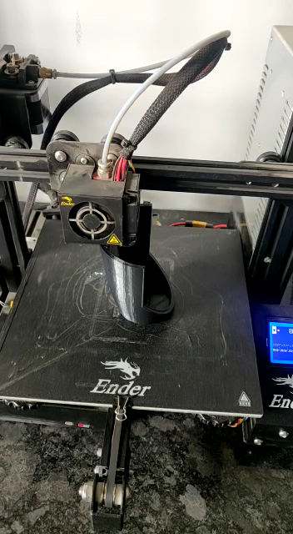
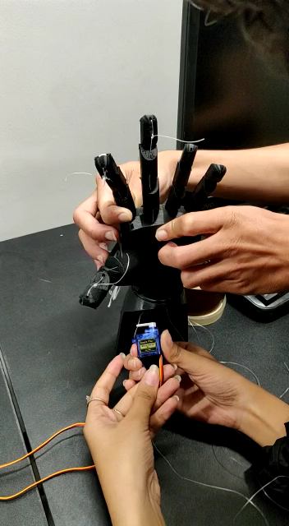
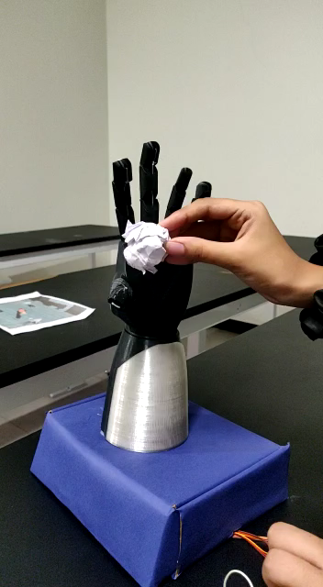

Slide 12
GROUP MEMBERS
Raghav Nimbalkar
Ishika Singh
Ishita Johri
Bhavya Hingad
Khushi Mundhada
20210802036
20210802063
20210802085
20210802116
20210802176

